Slide 1

DROWSY DRIVER ALERT SYSTEM
Proposed by
Ms Sadia Arshid
Presented by
Javeria Akhtar [1860-FBAS/BSCS/F09]
Sabina Irum [1861-FBAS/BSCS/F09]
Department of Computer Science & Software Engineering
Faculty of Basic &Applied Sciences
International Islamic University, Islamabad
2012
Notes:
Copyright (C) 2003 Internatioal Islamic University, Islamabad

Slide 2

Overview of Presentation
Introduction.
Existing System.
Problem Definition.
Proposed Solution.
System Requirements.
References
DCSSE/IIUI; Ms Sadia Arshid Drowsy driver alert system
Notes:
Copyright (C) 2003 Internatioal Islamic University, Islamabad

Slide 3
Introduction
This is a system that can monitor the alertness of drivers in order to prevent people from falling asleep at the wheel.
Our goal is the development of Driver Alert System based on drowsiness detection.
It is an interesting system which is used to reduce the percentage of road accidents.
DCSSE/IIUI; Ms Sadia Arshid Drowsy driver alert system
Notes:
Copyright (C) 2003 Internatioal Islamic University, Islamabad

Slide 4
Existing System
This alert system is introduced in the:
  America,
  China
  And other foreign countries
  But in Pakistan still it is not introduced.
Different image processing technology and applications of face and eye detection, is used now a days.
DCSSE/IIUI; Ms Sadia Arshid Drowsy driver alert system
Notes:
Copyright (C) 2003 Internatioal Islamic University, Islamabad

Slide 5
Problem Definition
There is a need to develop a software:
  That takes input of eye through camera placed in front of face or front mirror.
  So that it prevent people from falling asleep.
Then there should be a system/Software to perform related activities.
Driver alertness software for alerting the driver.
To facilitate the local users
DCSSE/IIUI; Ms Sadia Arshid Drowsy driver alert system
Notes:
Copyright (C) 2003 Internatioal Islamic University, Islamabad

Slide 6
Proposed Solution
Similar technology is available from Attention Technologies, Inc based on a called PERCLOS.
But the new developed system will be
  more cost effective solution
  especially for our country users.
  decrease the amount of death rates and save the life of the people.
It is a technology based on a facial detection algorithms.
DCSSE/IIUI; Ms Sadia Arshid Drowsy driver alert system
Notes:
Copyright (C) 2003 Internatioal Islamic University, Islamabad

Slide 7

Proposed Solution (Cont…)
In the 1st phase,
  Different facial recognition algorithms will be studied
In the 2nd phase,
  Implementing a system which calculates Blink Rate.
DCSSE/IIUI; Ms Sadia Arshid Drowsy driver alert system
Notes:
Copyright (C) 2003 Internatioal Islamic University, Islamabad

Slide 8
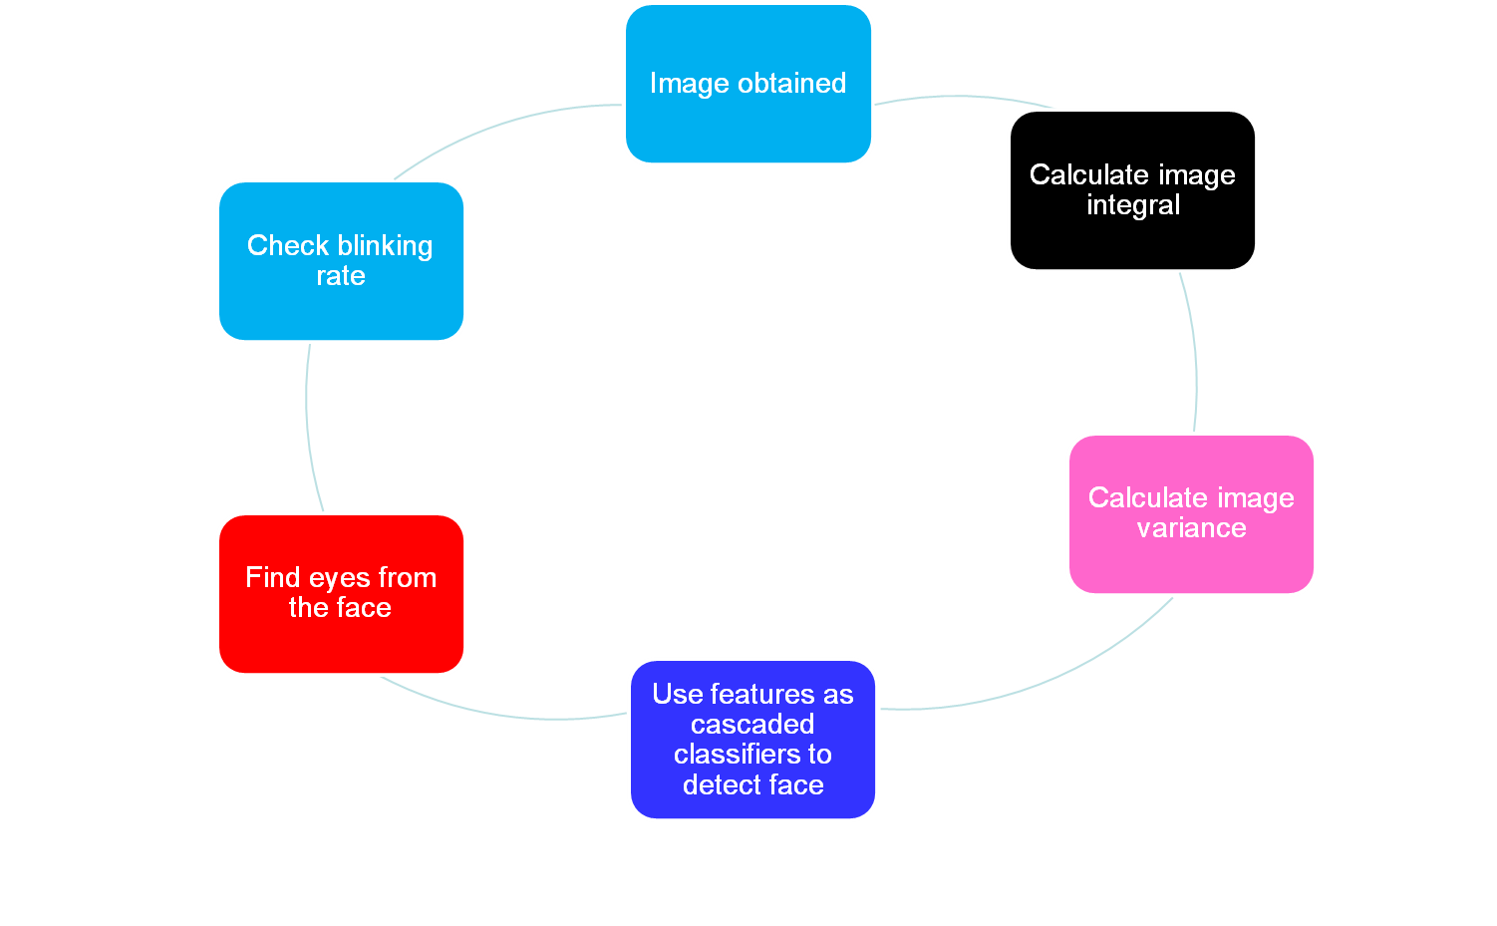
Working
DCSSE/IIUI; Ms Sadia Arshid Drowsy driver alert system
Notes:
Copyright (C) 2003 Internatioal Islamic University, Islamabad

Slide 9
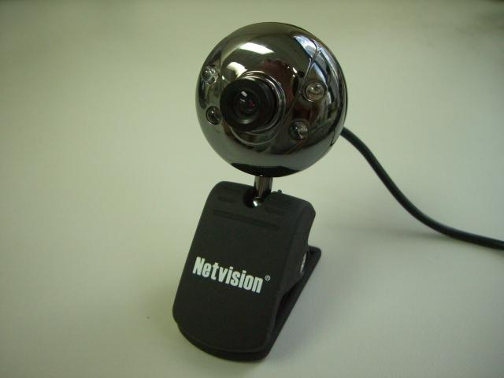
Left Click
Blinking capturer
A web cam is used to capture video and stream data to laptop
Web cam will be placed above rear view mirror
DCSSE/IIUI; Ms Sadia Arshid Drowsy driver alert system
Notes:
Copyright (C) 2003 Internatioal Islamic University, Islamabad

Slide 10
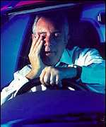
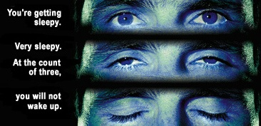
Facial recognition software
Facial detection techniques, focusing on developing an algorithm.
Different forms of feature detection software along with some image processing techniques available through MATLAB
Feature Recognition Algorithms
  MAT lab image processing
DCSSE/IIUI; Ms Sadia Arshid Drowsy driver alert system
Notes:
Copyright (C) 2003 Internatioal Islamic University, Islamabad

Slide 11
Literature Survey (Cont…)
Driver Alertness system
The outcome of this system will be eye detection.
This system will be used on any computer having webcam or camera.
Input will be taken from webcam or camera, a web cam is used to capture video and stream data to laptop.
Depending upon variable results, our system will trigger a series of alerts based on the level of drowsiness.
It will result to save the life of large number of people.
DCSSE/IIUI; Ms Sadia Arshid Drowsy driver alert system
Notes:
Copyright (C) 2003 Internatioal Islamic University, Islamabad

Slide 12
Literature Survey (Cont…)
Facial recognition Algorithms
Matlab
  Skin detection
  Motion detection
Kanade-Lucas-Tomasi Feature Tracker Algorithm (KLT)
Hough Transformation
Viola and Jones Algorithm
DCSSE/IIUI; Ms Sadia Arshid Drowsy driver alert system
Notes:
Copyright (C) 2003 Internatioal Islamic University, Islamabad

Slide 13
Literature Survey (Cont…)
Face detection using Matlab
Skin color has strong clustering features.
Skin color segmentation where possible skin pixels are assigned a value of 1 and background pixels are assigned a value of zero.
Each pixel is examined separately and is considered a skin pixel if it lies in the skin region boundaries which were determined experimentally.
DCSSE/IIUI; Ms Sadia Arshid Drowsy driver alert system
Notes:
Copyright (C) 2003 Internatioal Islamic University, Islamabad

Slide 14
Motion detection
Take the input video from camera.
Convert this input video to grayscale image.
Compare the two frames for the detection of movement.
Store the value in a variable if movement is detected and then add these values and compare to produce a beep sound.
DCSSE/IIUI; Ms Sadia Arshid Drowsy driver alert system
Notes:
Copyright (C) 2003 Internatioal Islamic University, Islamabad

Slide 15
MPT (Machine Perception Toolbox)
MPT is a toolbox that supplies cross-platform libraries for real-time perception primitives, including face detection, eye detection, blink detection, and color tracking.
It is a C++ based facial recognition program
Implements Viola and Jones Algorithm
Allows real time Eye detection
Is easy to use
B-val is used to calculate extent of eye openness
Frame Rate = 50 frames/sec
DCSSE/IIUI; Ms Sadia Arshid Drowsy driver alert system
Notes:
Copyright (C) 2003 Internatioal Islamic University, Islamabad

Slide 16
METHODOLOGY
Following are the list of methodologies used for this project:
Skin color sampling
Skin detection
Motion detection
Face object
Eye object
DCSSE/IIUI; Ms Sadia Arshid Drowsy driver alert system
Notes:
Copyright (C) 2003 Internatioal Islamic University, Islamabad

Slide 17
References
[1] http://www.tgsa.edu/online/cybrary/gbarfoot.html
[2]http://blogs.automotive.com/volvos-driver-alert-control-keeps-car-drivers-awake-9436.html#ixzz2FW4lzjf0
[3] Weirwille, W.W. (1994). “Overview of Research on Driver Drowsiness Definition
and Driver Drowsiness Detection,” 14th International Technical Conference on
Enhanced Safety of Vehicles, pp 23-26.
http://www.ee.ryerson.ca/~phiscock/thesis/drowsy-detector/drowsy-detector.pdf
[4]http://blogs.automotive.com/volvos-driver-alert-control-keeps-car-drivers-awake-9436.html#ixzz2FWFJLwPJ
DCSSE/IIUI; Ms Sadia Arshid Drowsy driver alert system
Notes:
Copyright (C) 2003 Internatioal Islamic University, Islamabad

Slide 18
Q & A
Q & A
Thank You
DCSSE/IIUI; Ms Sadia Arshid Drowsy driver alert system
Notes:
Copyright (C) 2003 Internatioal Islamic University, Islamabad

